Slide 1
WPF Tutorial
A short introduction into WPF basic concepts including MVVM, Data Templating, XAML-tricks…

Slide 2
Agenda
About me and my background (~15 min)
Definition of MVC & MVVM (~15min)
WPF Live Demo (~1,5-3,5 hours)

Slide 3

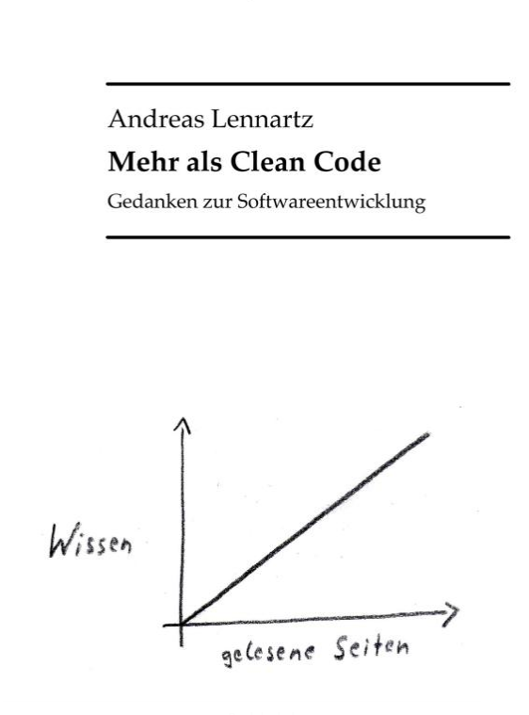
Andreas Lennartz
C# developer since 2001 (.NET 1.1)
~2 years GUI-design with WPF/XAML @AirBerlin (6 years ago)
Github-repositories
Such mich – a wpf based game
WPF Fundamentals – common classes lib
Author of „Mehr als Clean Code“
www.andreaslennartz.de
Slides and Code of this presentation on GitHub:
https://github.com/roadrunnerlenny/wpftutorial.git

Slide 4
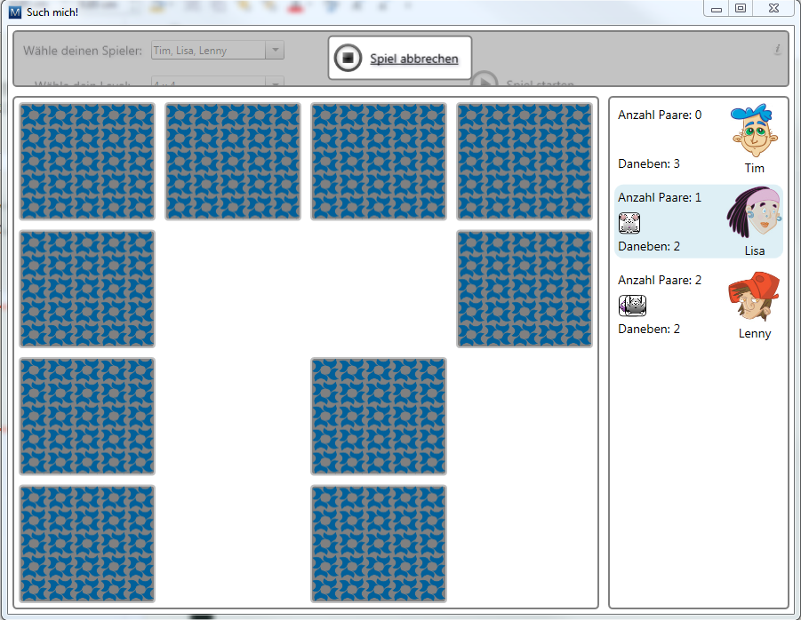
Such mich
Such Mich! is a game based on the famous game "Memory" (aka "Find the pairs")
Live Demo

Slide 5
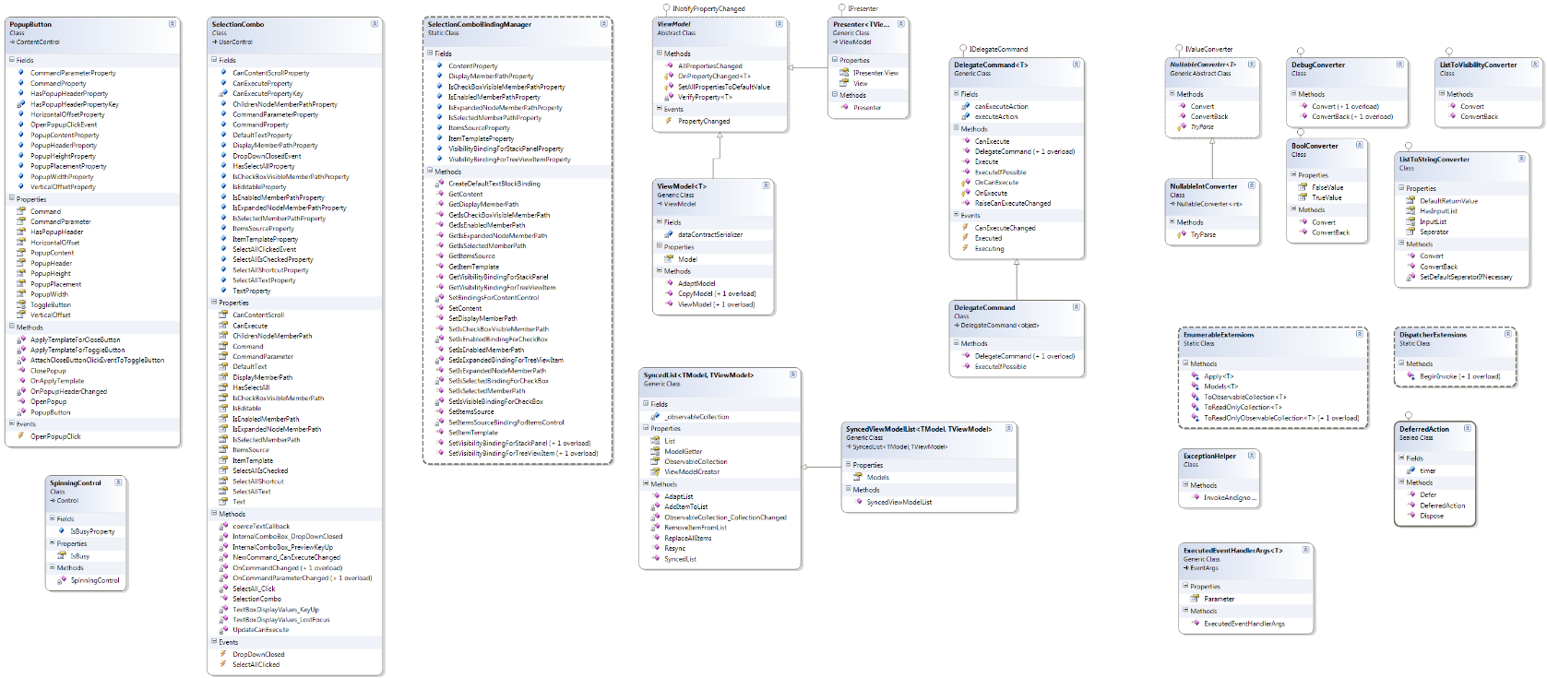
WPF Fundamentals
WPF Fundamentals is a toolset with basic classes to use in any common WPF project.
MVVM support
DelegateCommand
Common converter
…(other stuff)

Slide 6
Agenda
About me and my background (~15 min)
Definition of MVC & MVVM (~20min)
WPF Live Demo (~2-4 hours)

Slide 7
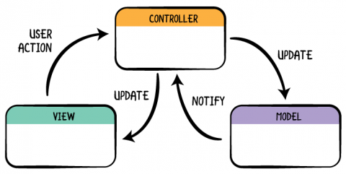
MVC
Model, View, Controller
Controller <->View and Model <-> Controller
Model sometimes interacts with View directly
→ On the paper everything is loosely coupled, but in reality not

Slide 8
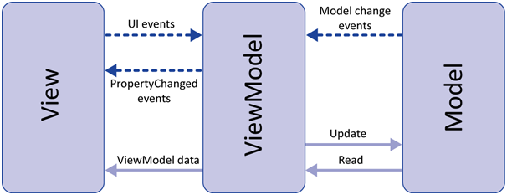
MVVM
Model, View, ViewModel
View „binds“ to ViewModel
ViewModel capsuslates Model
Data-Driven Development – Model & Logic are equal
→ Bindings make the View fully replacable and the ViewModel testable

Slide 9
Agenda
About me and my background (~15 min)
Definition of MVC & MVVM (~20min)
WPF Live Demo (~2-4 hours)

Slide 10
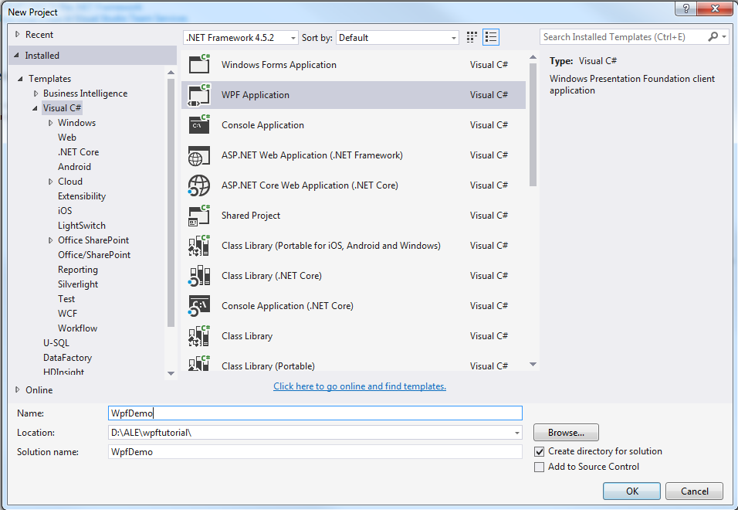
Creating demo application
Lemon Log Viewer (LLV)
Topics covered
View Model Basics
Bindings
Converter
Style & Trigger
Data Template
Commands
Different Controls / CustomControls
Dependency Props / Attached Props
Live demo
Attention: Save the project *not* on network share (issues with XAML designer when creating namespaces for assemblies)
Notes:
Here the script starts…

